Slide 1
Database Systems
Lecture 20
Types of Joins

Slide 2
Today’s agenda
Joins in database
Natural Join
Inner Join
Equi Join
Theta Join
Semi Join
Anti Join
Cross Join
Outer Join
Left Outer Join
Right Outer Join
Full Outer Join
Self Join

Slide 3
Join
Join is a special form of cross product of two tables. In Cartesian product we join a tuple of one table with the tuples of the second table.
But in join there is a special requirement of relationship between tuples.
The JOIN operation can be specified as a CARTESIAN PRODUCT operation followed by a SELECT operation.
To illustrate JOIN, suppose that we want to retrieve the name of the manager of each department.
To get the manager’s name, we need to combine each department tuple with the employee tuple whose Ssn value matches the Mgr_ssn value in the department tuple.

Slide 4
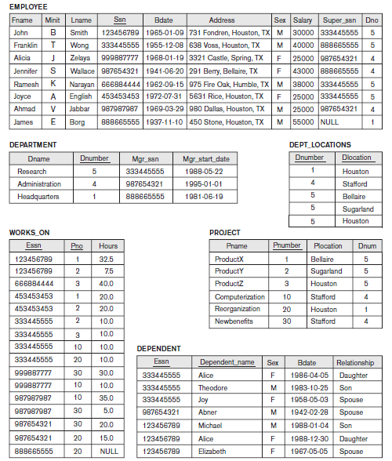

Slide 5

Join
We do this by using the JOIN operation and then projecting the result over the necessary attributes, as follows:

Slide 6
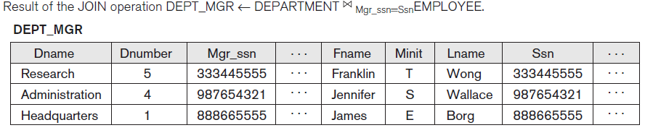
Join
Note that Mgr_ssn is a foreign key of the DEPARTMENT relation that references Ssn, the primary key of the EMPLOYEE relation.
This referential integrity constraint plays a role in having matching tuples in the referenced relation EMPLOYEE.

Slide 7

Join

Slide 8
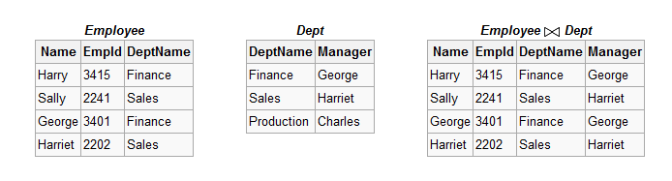
Natural Join
Natural join ( ) is a binary operator that is written as (R S) where R and S are relations.
In particular, natural join allows the combination of relations that are associated by a foreign key.

Slide 9
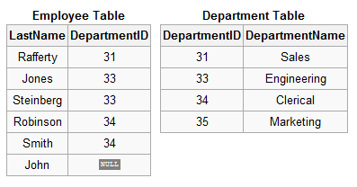

Slide 10

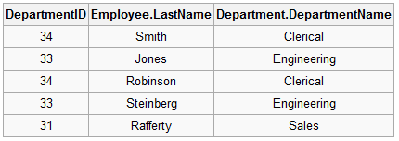
Natural Join (Example)

Slide 12
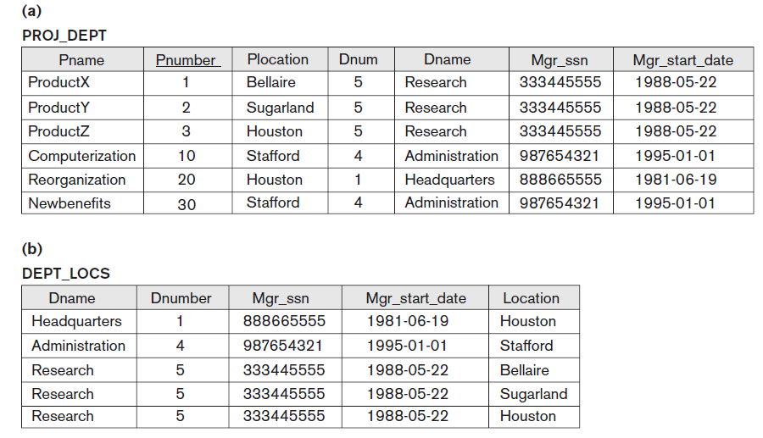
Result of Two Natural Join

Slide 13
Inner join
An inner join is the most common join operation used in applications and can be regarded as the default join-type.
Inner join creates a new result table by combining column values of two tables (A and B) based upon the join-predicate.
The query compares each row of A with each row of B to find all pairs of rows which satisfy the join-predicate. When the join-predicate is satisfied, column values for each matched pair of rows of A and B are combined into a result row.

Slide 14
Equijoin
An equi-join, also known as an equijoin, is a specific type of comparator-based join, or theta join, that uses only equality comparisons in the join-predicate.
Using other comparison operators (such as <) disqualifies a join as an equi-join.

Slide 16


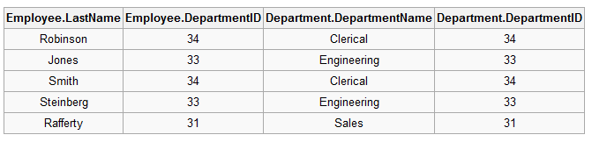
Equijoin (Example)

Slide 17
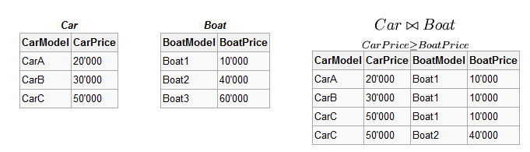
θ-join
Consider tables Car and Boat which list models of cars and boats and their respective prices. Suppose a customer wants to buy a car and a boat, but she does not want to spend more money for the boat than for the car.
The θ-join on the relation CarPrice ≥ BoatPrice produces a table with all the possible options.

Slide 18

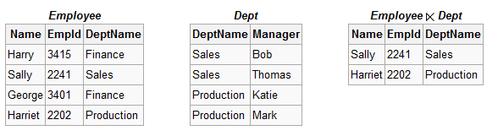
Semi Join ( ) and ( )
The left semijoin is joining similar to the natural join and written as R S where R and S are relation. The result of this semijoin is only the set of all tuples in R for which there is a tuple in S that is equal on their common attribute names.
For example, consider the tables Employee and Dept and their semi join:

Slide 19
Semi Join (Example)
SELECT * FROM departments
WHERE EXISTS
(SELECT * FROM employees WHERE departments.department_id = employees.department_id AND employees.salary > 2500)
ORDER BY department_name;

Slide 20
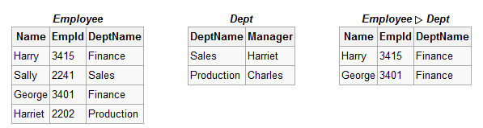
Antijoin( )
The antijoin, written as R S where R and S are relations, is similar to the natural join, but the result of an antijoin is only those tuples in R for which there is no tuple in S that is equal on their common attribute names.
For an example consider the tables Employee and Dept and their antijoin:

Slide 21
Anti Join (Example)
SELECT * FROM employees
WHERE department_id NOT IN
(SELECT department_id FROM departments WHERE location_id = 1700) ORDER BY last_name;

Slide 22


Cross Join
CROSS JOIN returns the Cartesian product of rows from tables in the join. In other words, it will produce rows which combine each row from the first table with each row from the second table.

Slide 23
Outer Join
An outer join does not require each record in the two joined tables to have a matching record. The joined table retains each record—even if no other matching record exists.
Outer joins subdivide further into left outer joins, right outer joins, and full outer joins, depending on which table(s) one retains the rows from (left, right, or both).

Slide 24
Left Outer Join
The result of a left outer join (or simply left join) for table A and B always contains all records of the "left" table (A), even if the join-condition does not find any matching record in the "right" table (B).
This means that if the ON clause matches 0 (zero) records in B, the join will still return a row in the result—but with NULL in each column from B.
This means that a left outer join returns all the values from the left table, plus matched values from the right table (or NULL in case of no matching join predicate).
If the right table returns one row and the left table returns more than one matching row for it, the values in the right table will be repeated for each distinct row on the left table.

Slide 26

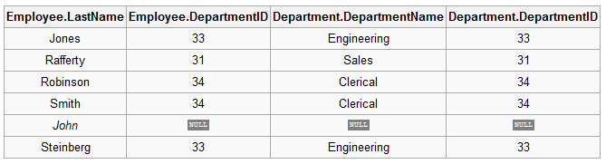
Left Outer Join (Example)

Slide 27
Right Outer Join
A right outer join (or right join) closely resembles a left outer join, except with the treatment of the tables reversed.
Every row from the "right" table (B) will appear in the joined table at least once.
If no matching row from the "left" table (A) exists, NULL will appear in columns from A for those records that have no match in B.
A right outer join returns all the values from the right table and matched values from the left table (NULL in case of no matching join predicate).

Slide 29

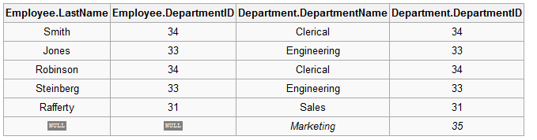
Right Outer Join (Example)

Slide 30
Full Outer Join
Conceptually, a full outer join combines the effect of applying both left and right outer joins.
Where records in the FULL OUTER JOINed tables do not match, the result set will have NULL values for every column of the table that lacks a matching row.
For those records that do match, a single row will be produced in the result set (containing fields populated from both tables).

Slide 32

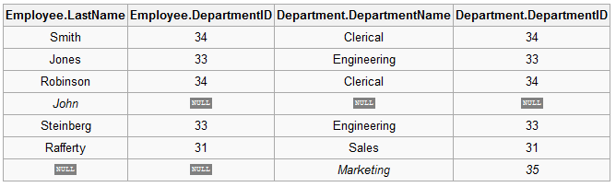
Full Outer Join (Example)

Slide 33
Self Join
A self-join is joining a table to itself. This is best illustrated by an example.
A query to find all pairings of two employees in the same country is desired. If there were two separate tables for employees and a query which requested employees in the first table having the same country as employees in the second table, a normal join operation could be used to find the answer table. However, all the employee information is contained within a single large table.

Slide 34
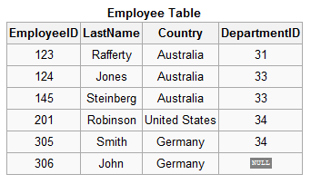
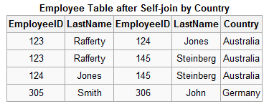

Self Join (Example)

Slide 35
